Slide 1


Primitive Data Types

Slide 2






This comic was created as part of the Comixplain research project, funded by the University of Applied Sciences St. Pölten (USTP) through the Innovation Call 2022.
Project Team:
Victor-Adriel De-Jesus-Oliveira
Hsiang-Yun Wu
Christina Stoiber
Magdalena Boucher
Alena Boucher
Contact:
victor.oliveira@ustp.at
Illustrations: Magdalena Boucher & Alena Boucher
Primitive Data Types © 2025 by Comixplain Team (Victor-Adriel De-Jesus-Oliveira, Hsiang-Yun Wu, Christina Stoiber, Magdalena Boucher, and Alena Boucher) with illustrations by Magdalena Boucher and Alena Boucher, University of Applied Sciences St. Pölten (USTP), licensed under CC BY-SA 4.0
https://www.comixplain.cc

Slide 3
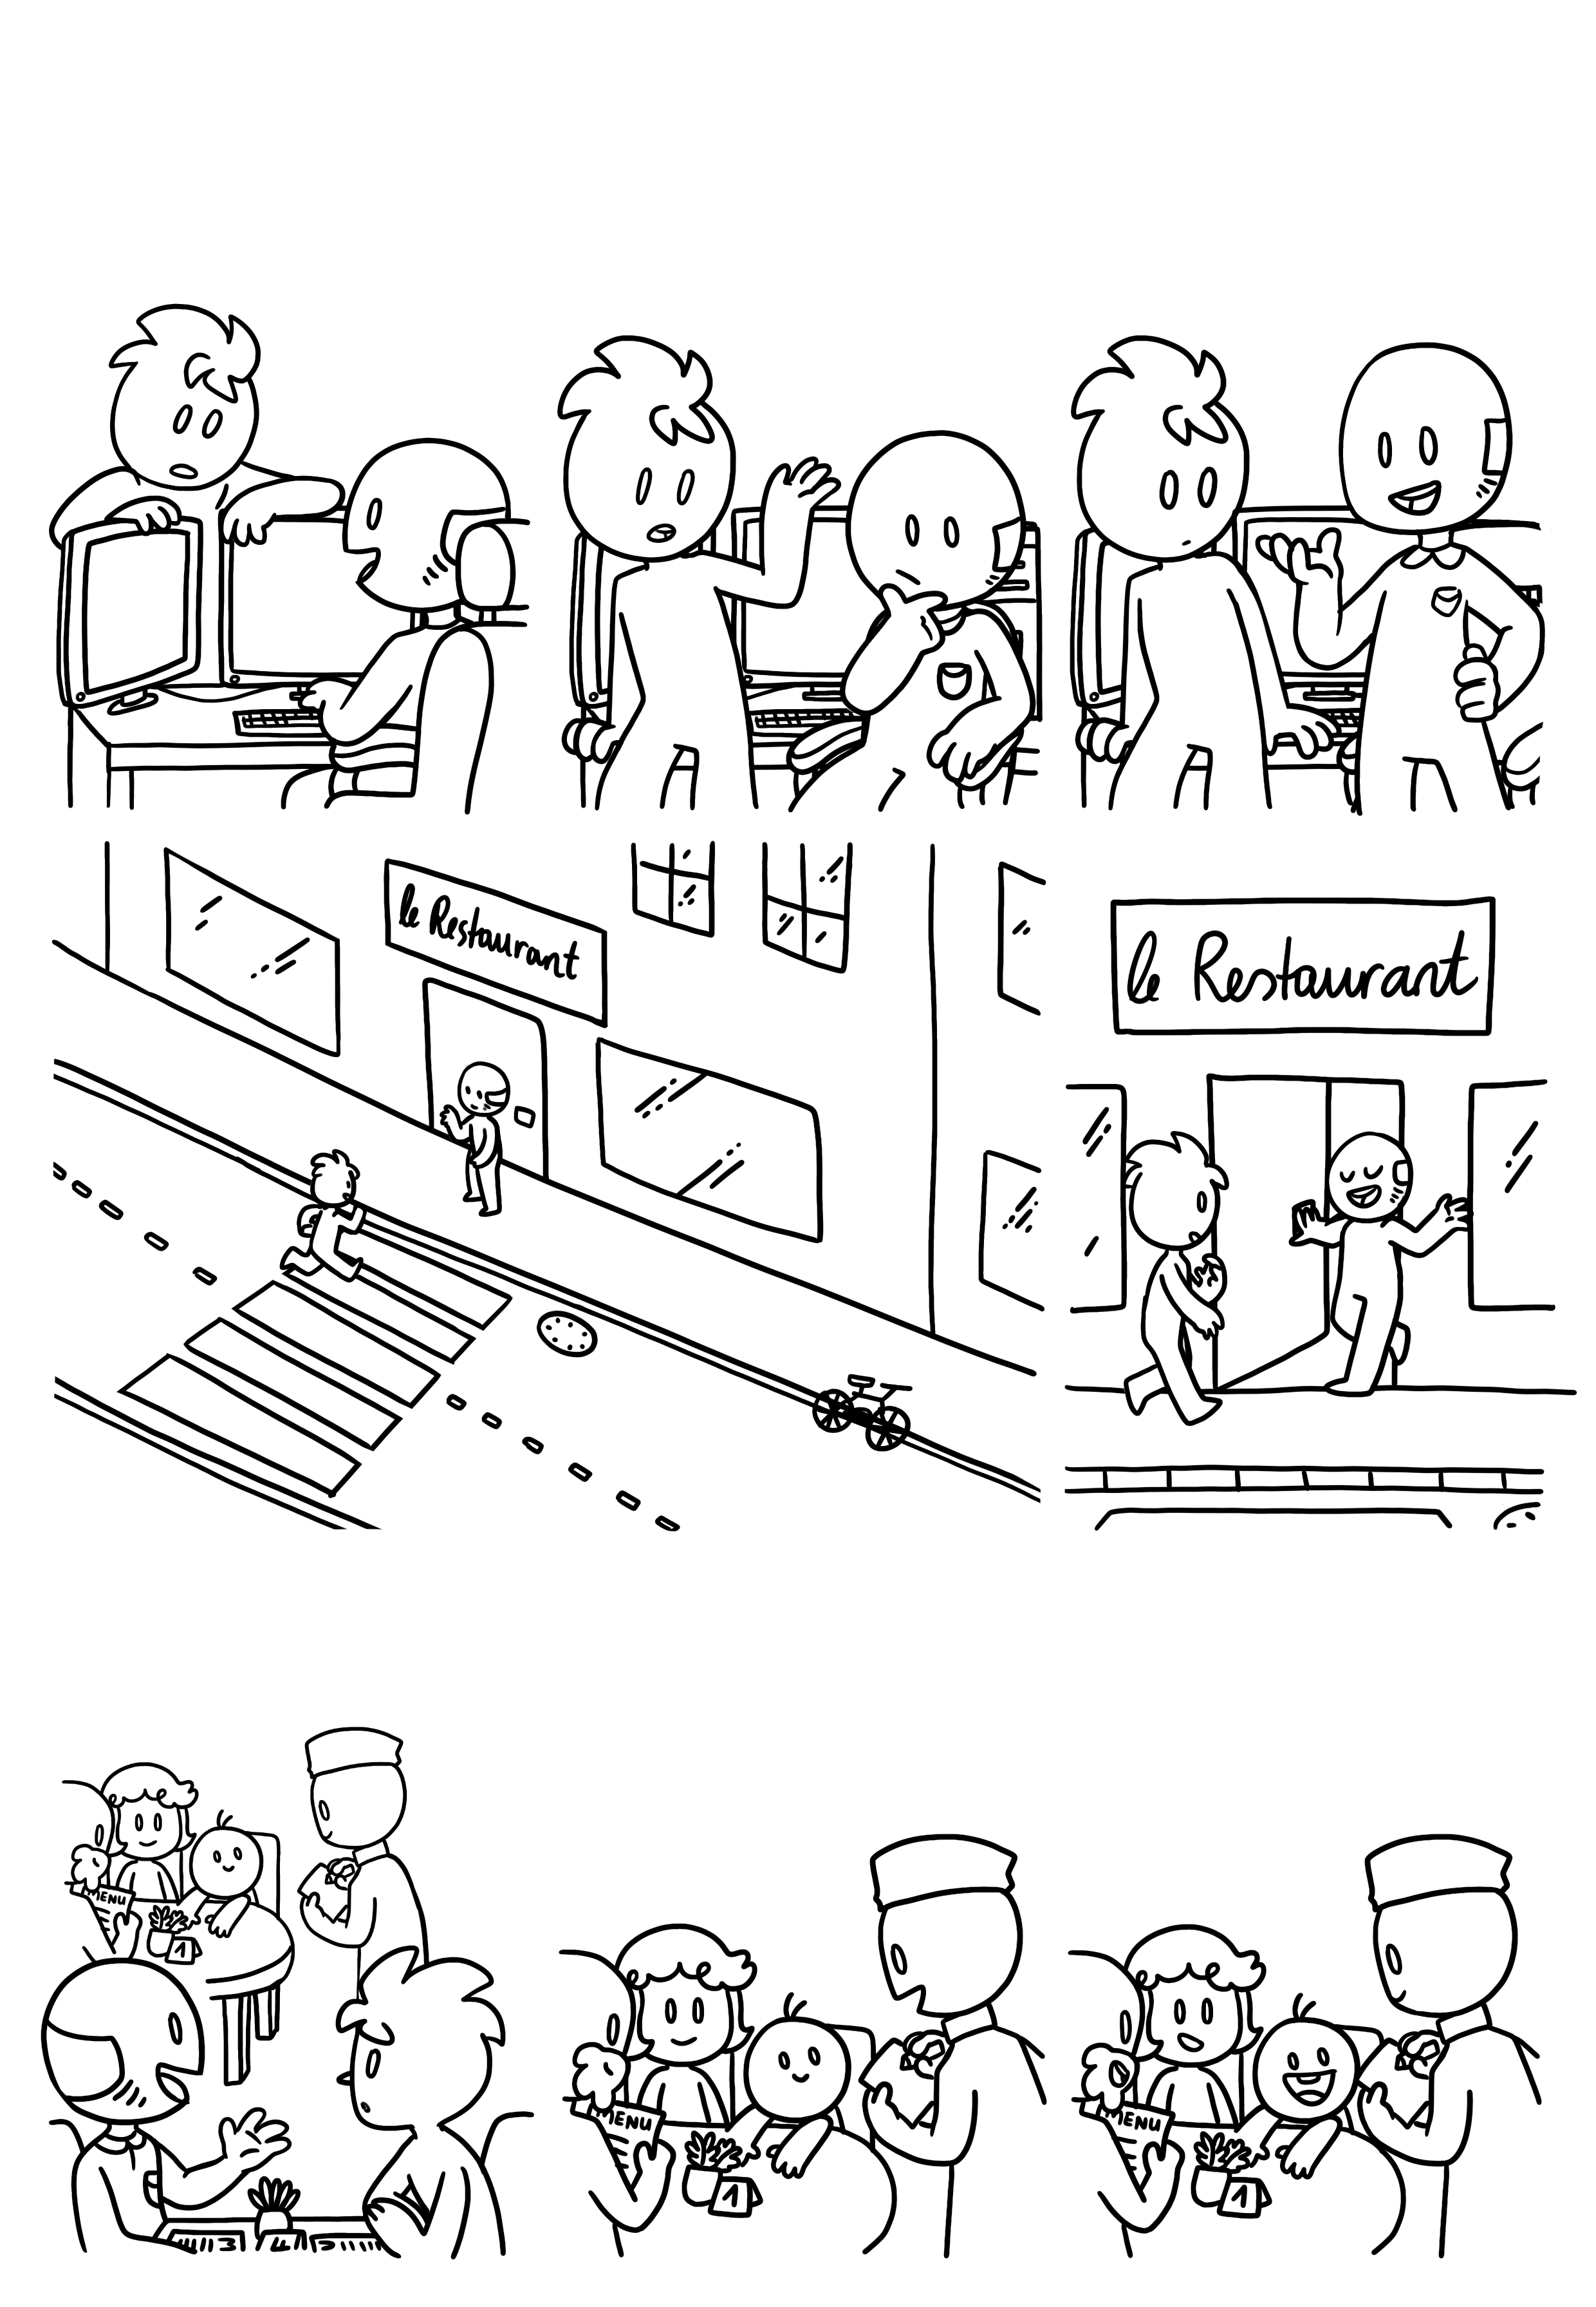
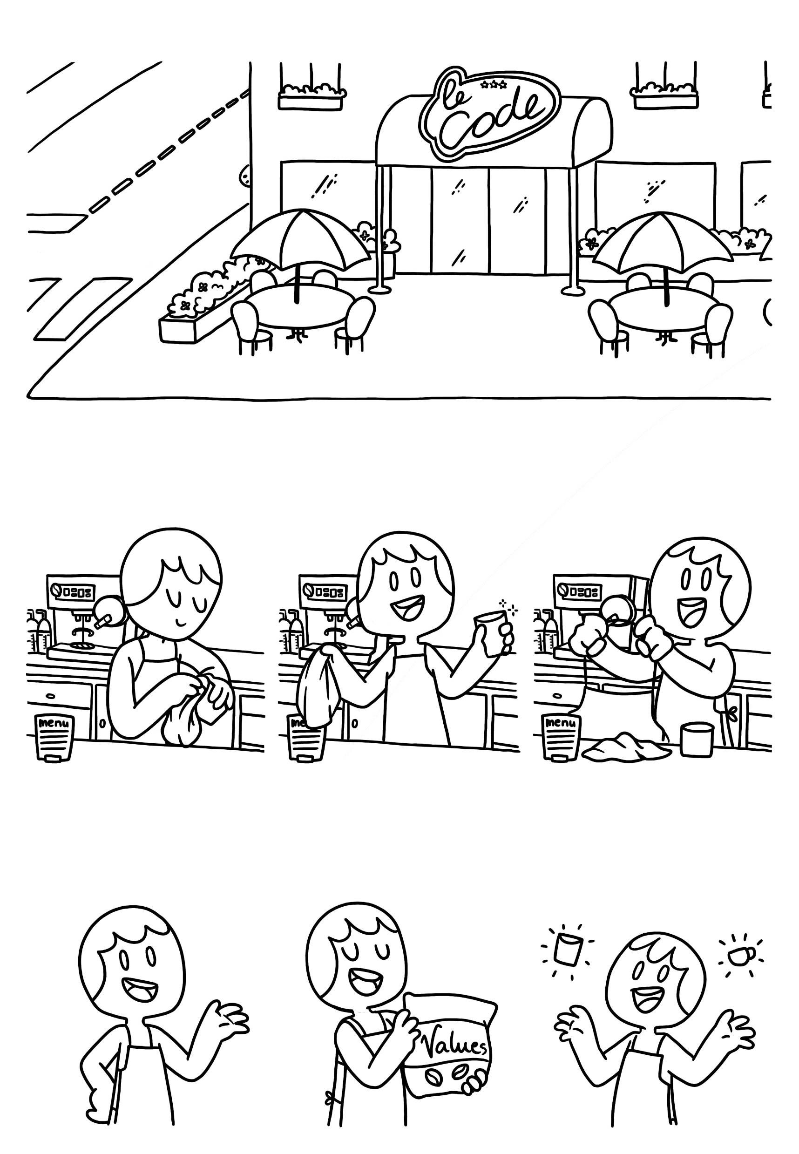
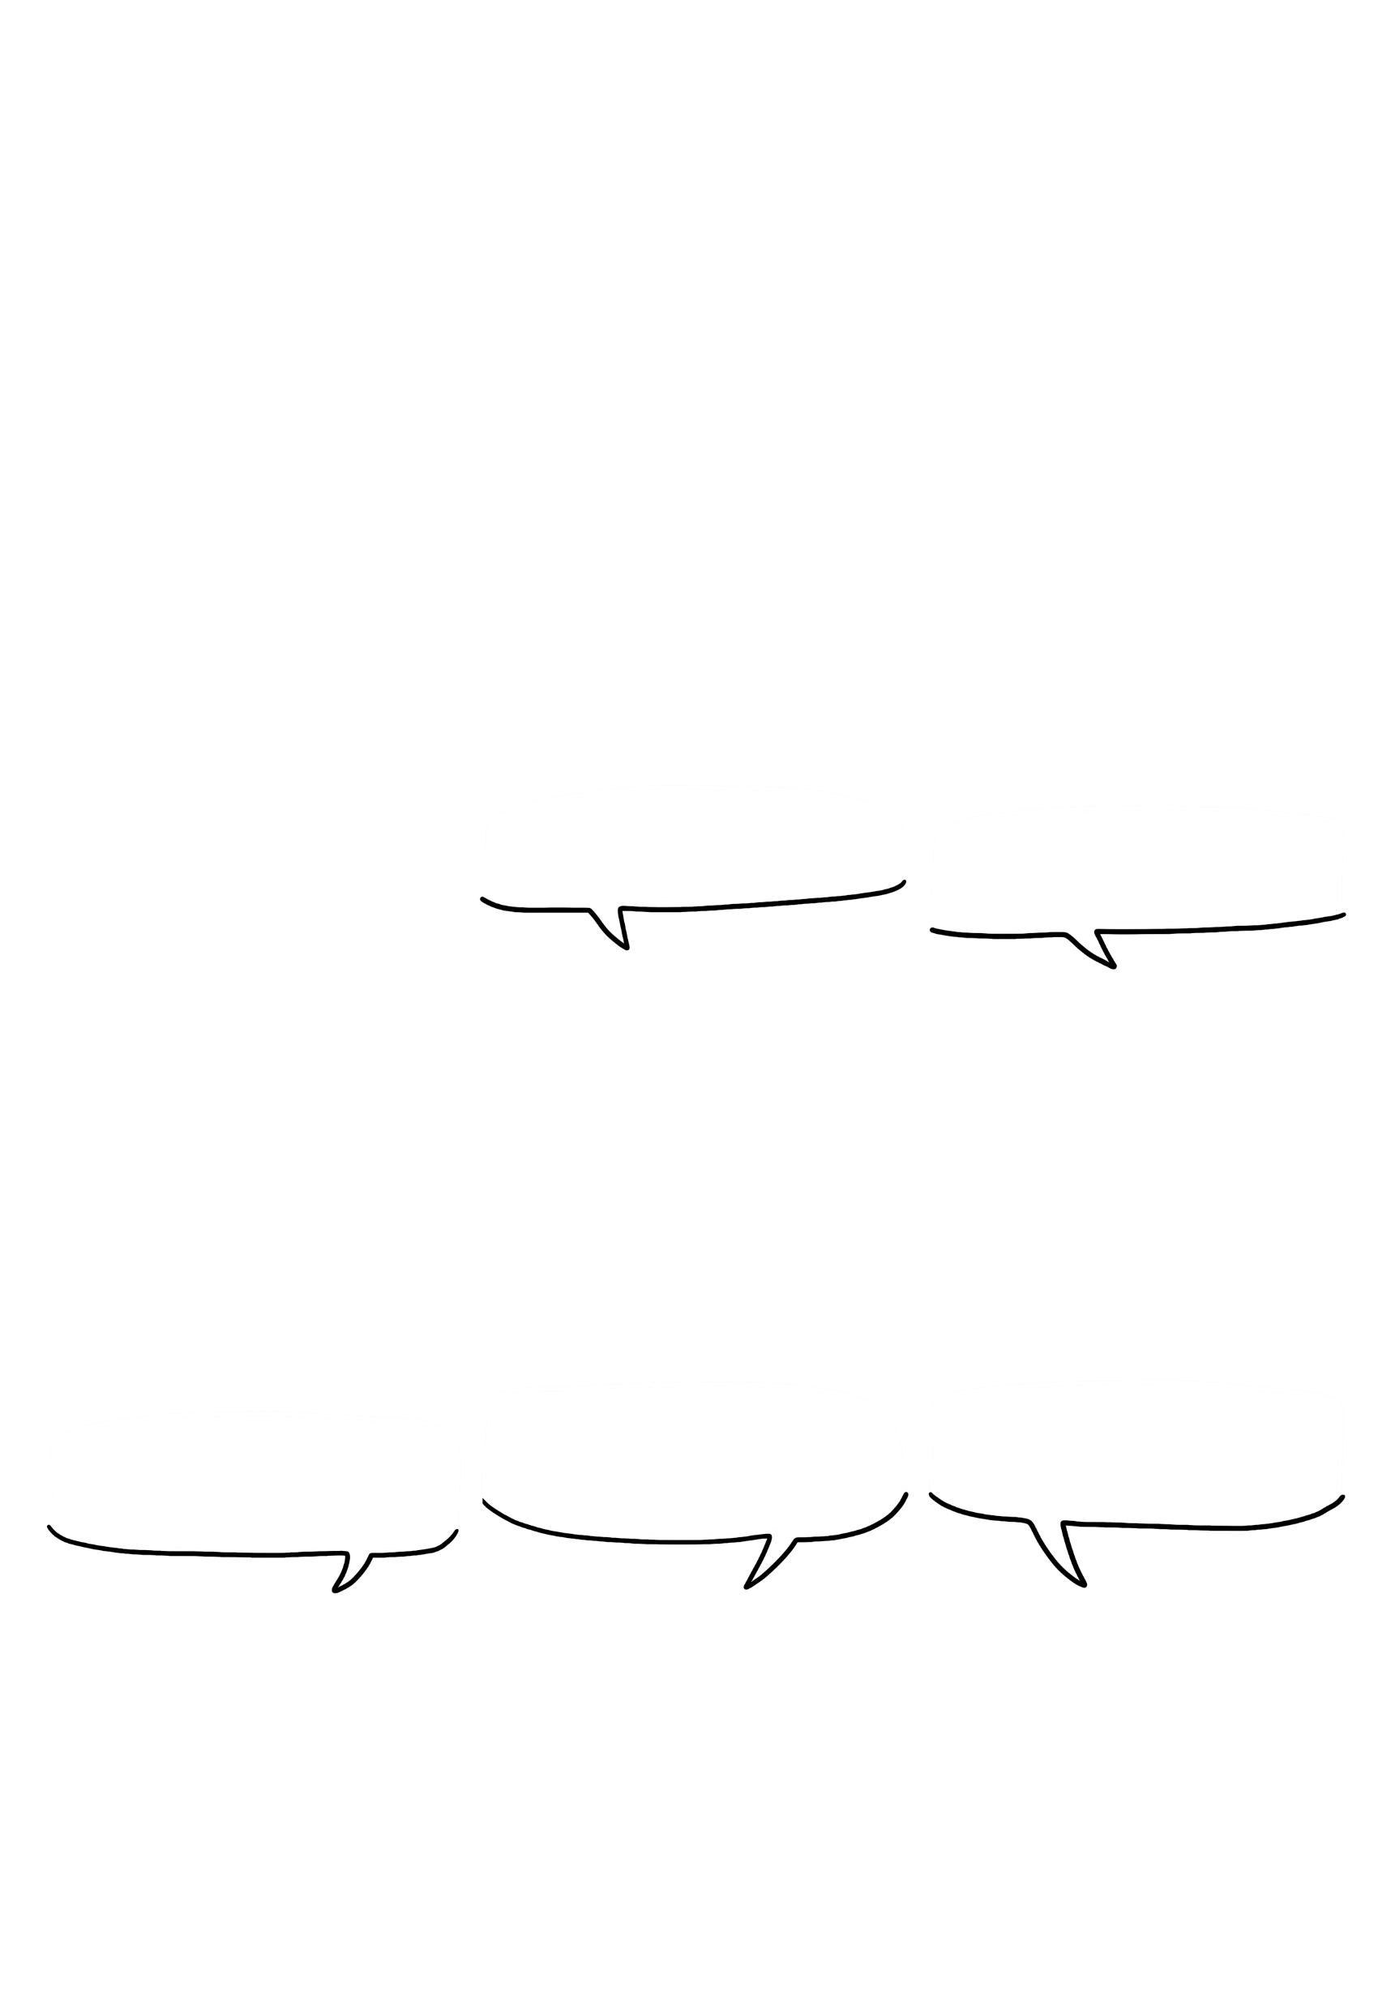
Oh, you must be the new hire our manager was talking about!
You know what? Let‘s talk about this over lunch at the restaurant down the road!
Primitive Data Types
What do you mean you‘re not?
Of course you are! Here‘s your apron. Come with me and I will show you the ropes quickly.
Your job is to execute orders from the program, uh, I mean the kitchen…
And to put values
…uhm coffee…
Into containers!

Slide 4
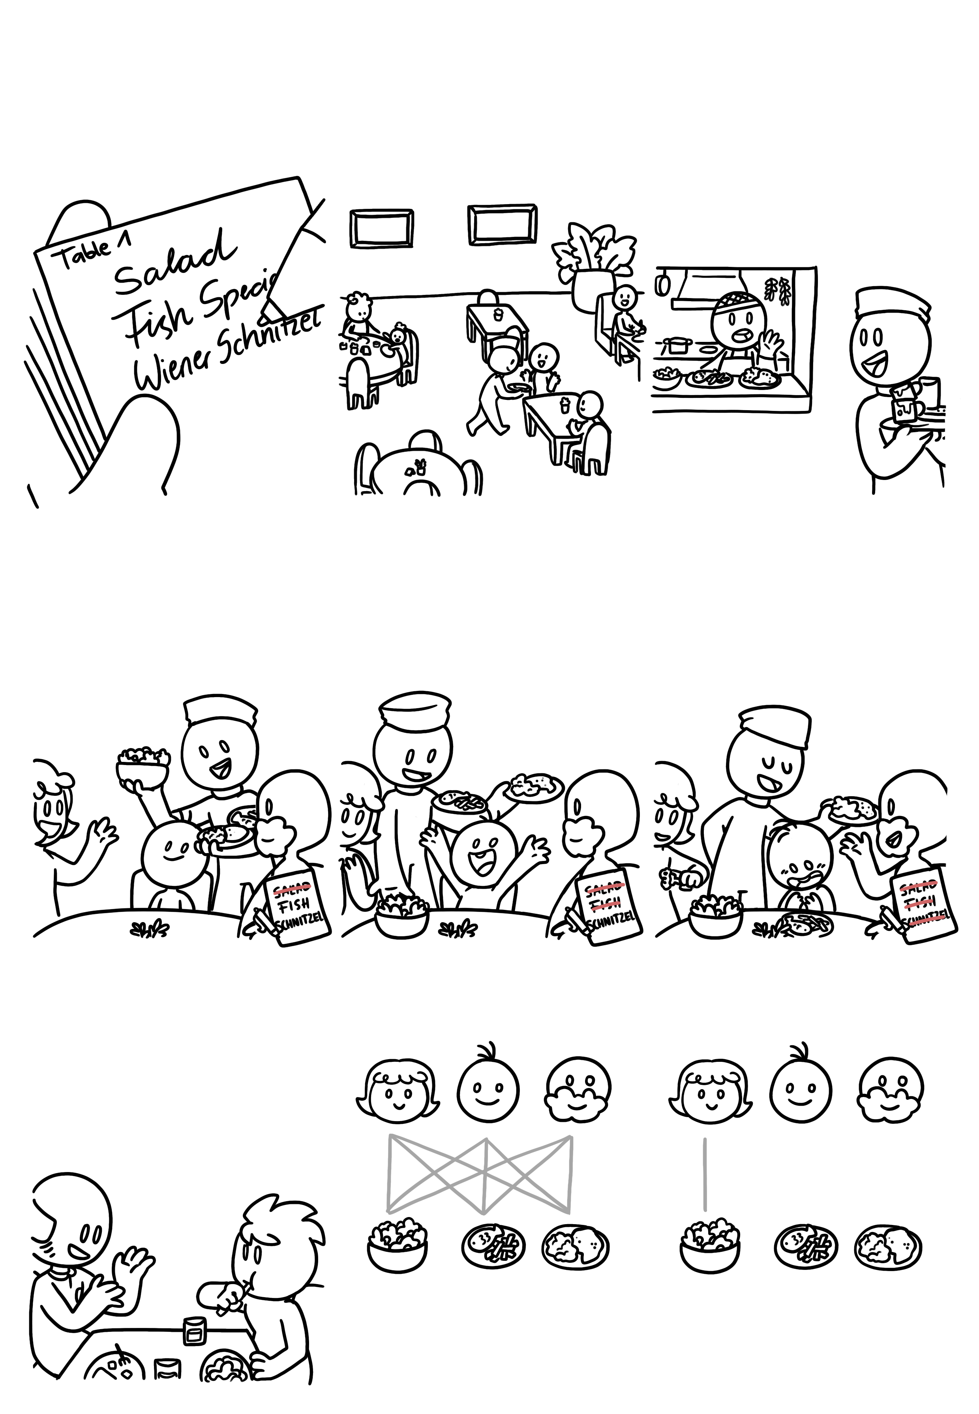
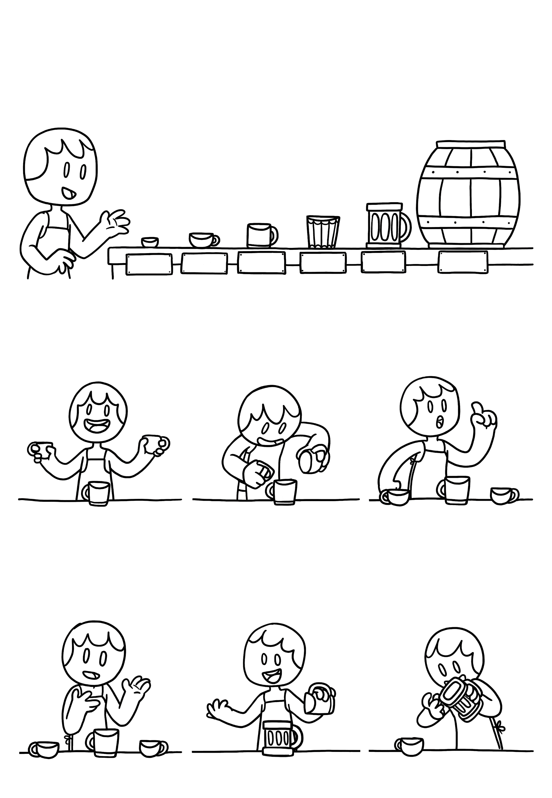



Here are our different containers that we use. Don‘t worry about the exact number ranges.
Primitive Data Types
+ - 4,9E - 324
+ - 1,7E + 308
+ - 1,4E - 45
+ - 3,4E + 38
-32,768
+ 32 767
- 2 x 10^9
+ 2 x 10^9
- 9 x 10^18
+ 9 x 10^18
-128
+127
BYTE
SHORT
INT
LONG
FLOAT
DOUBLE
Sometimes you‘ll have to pour the contents of glasses into others.
Just be mindful of one thing.
Easy isn‘t it?
20
20
20 + 20
=
40
20
40
20
Int
You‘re actually not emptying the original glass but copying the content into a new cup.
Also, you can always copy the content of a smaller glass into a larger one.
But what happens when we pour a float into a short?
20
40
20

Slide 5
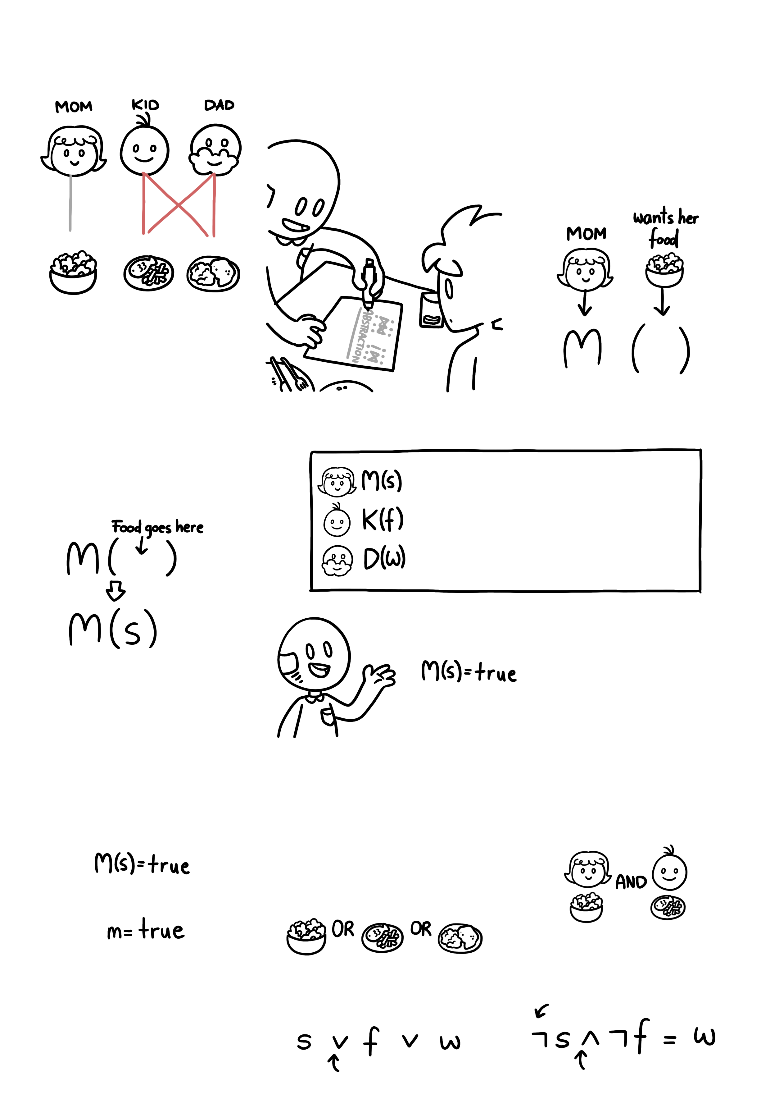
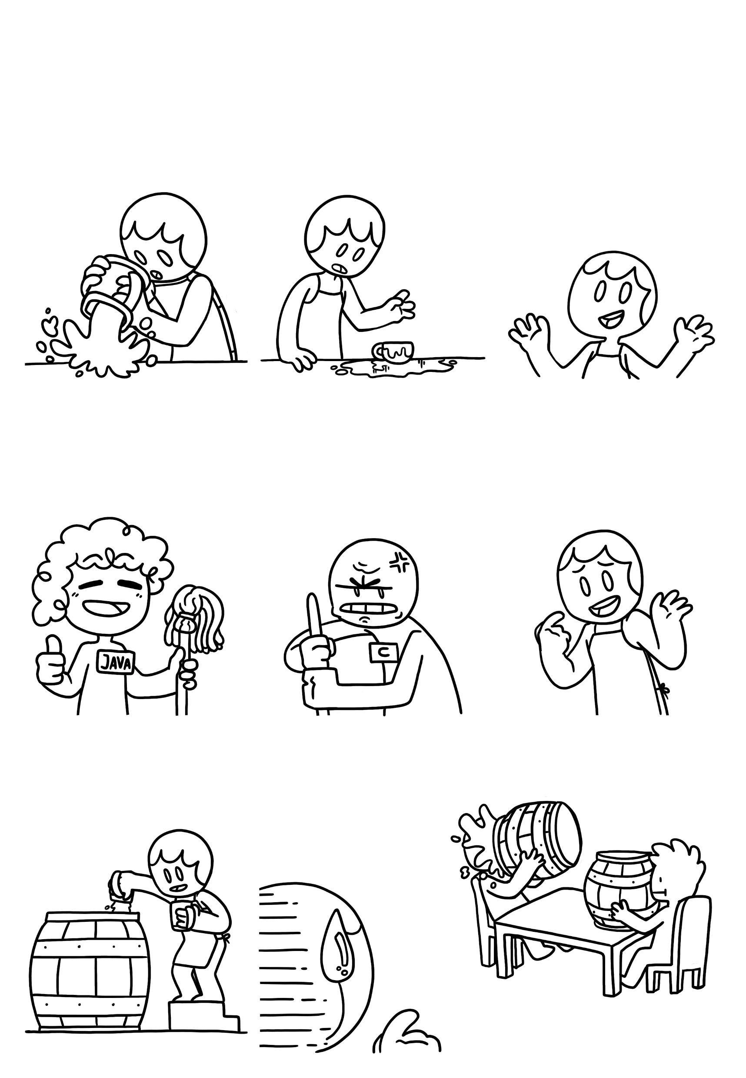

Only a part of it will fit.
Primitive Data Types
And the rest will leave a huge mess on the counter.
And whether that’s bad depends on the manager you’re working with,
See this person here? She won’t be bothered much and will clean it up for you.
But NEVER do this under his watch. He will throw a fit!
So depending on what you are working on, try to avoid it.
You may ask yourself why don’t we just put everything into doubles.
…but there wouldn’t be much space left on the tables…
So please choose appropriate sizes.

Slide 6
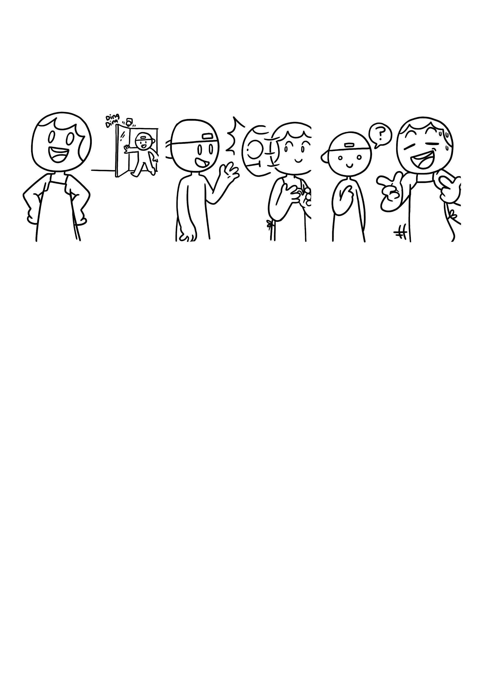
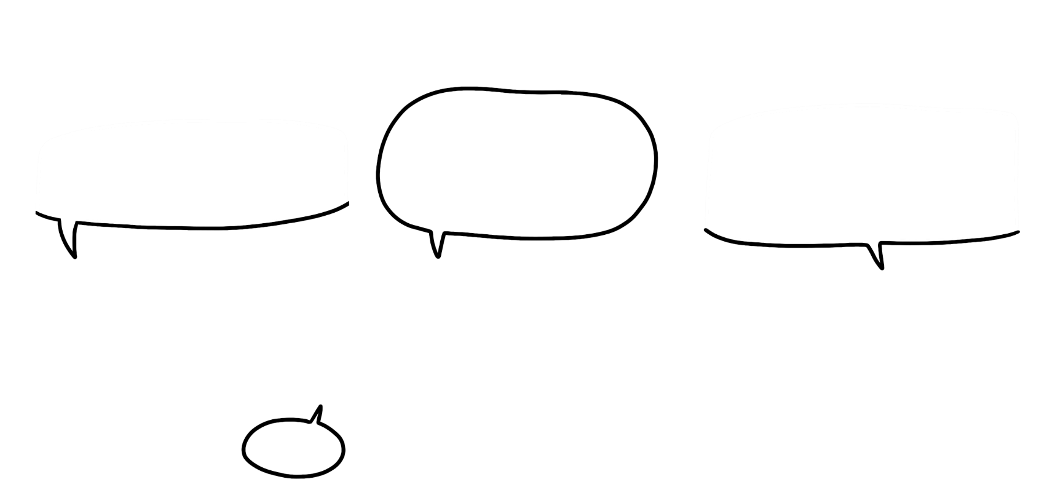

This is all you need to know to get started, so enjoy your first da-
Primitive Data Types
I’m the new hire and my first shift should start today. I was told to come to you.
You know what? I’m quite busy, how about you explain them what to do!
Hello!
How would you explain the concept of primitive data types to the new employee? Use this space to make notes and drawings.

Slide 7


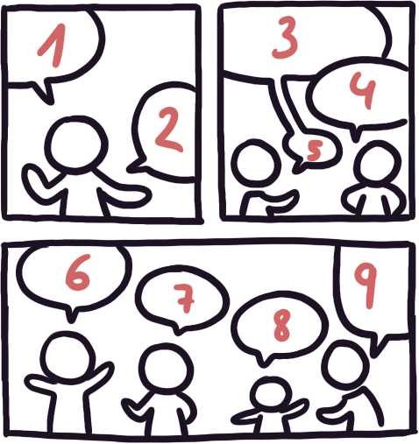






Primitive Data Types
C# (C-Sharp)
Primitive types are predefined by the programming language itself. Here are the equivalent types and their ranges for other languages.
- 1.80e308
+ 1.80e308
- 3.40e38
+ 3.40e38
- 9 x10^18
+ 9 x10^18
- 2 x10^9
+ 2 x10^9
-128
+127
-32768
+ 32767
sbyte
short
int
long
float
double
C# also includes:
bool: a boolean value (true or false).
char: a Unicode character (U+0000 to U+FFFF).
Javascript
Be aware that primitive types provide the programmer with essential data types for storing and manipulating data efficiently, often optimized for performance and memory usage.
Number: Represents all numeric values*
Boolean: Represents a boolean value (true or false)
String: Represents a sequence of characters
Undefined: Represents an uninitialized or undefined value
Null: Represents an intentional absence of any object value
*The type “number” includes integers and floating-point numbers. JavaScript doesn't have specific types like byte, short, or long.
Python
While many languages share similar primitive types such as integers, boolean values, and characters, the specific names, ranges, and behaviors of these types can vary between languages.
int: Represents arbitrary precision signed integers.
float: Represents floating-point numbers*
bool: Represents a boolean value (true or false).
str: Represents a sequence of Unicode characters.
NoneType: Represents the absence of a value, often used as a placeholder or default return value.
*The range of float is approximately 1.7e-308 to 1.7e+308

Slide 8

How to cite this document: Boucher, M., Boucher, A., Wu, H.-Y., & Stoiber, C., & De-Jesus-Oliveira, V.-A. (2025). Primitive Data Types. University of Applied Sciences St. Pölten (USTP). https://www.comixplain.cc This comic book was adapted from: Primitive Data Types © 2024 by Comixplain Team: Victor-Adriel De-Jesus-Oliveira, Hsiang-Yun Wu, Christina Stoiber, Magdalena Boucher, and Alena Ertl, with illustrations by Magdalena Boucher and Alena Ertl, all employed by Sankt Pölten University of Applied Sciences is licensed under CC BY-SA 4.0.
Sources:
Knudsen, J., & Niemeyer, P. (2005). Learning Java. O'Reilly.
Mughal, K. A., & Rasmussen, R. W. (2003). A programmer's guide to Java certification: a comprehensive primer. Addison-Wesley Professional.

